Slide 1
Functions in Python
Dr. Ashwin Bhagat

Slide 2
Functions in Python
Python functions are reusable blocks of code used to perform a specific task. They help organize programs into smaller sections and execute the same logic whenever needed by calling the function.
Functions are used for:
  Code Reusability
  Modularity
  Readability
  Maintainability

Slide 3
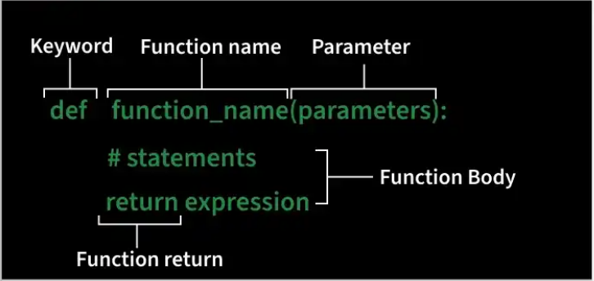

Slide 4
Defining a Function
def fun():
  print(“This is a Function”)
After creating a function, call it by using the name of the functions followed by parenthesis containing parameters of that particular function.
fun()

Slide 5
Function Arguments
Arguments are values passed to a function when it is called. They allow functions to receive input data and perform operations using those values.
Syntax
  def fun_name(arguments):
    #function_body
    return value
  def function_name(arguments): defines a function with optional arguments.
  # function body contains the statements to be executed.
  return value returns a result from the function. If no return statement is used, it returns None by default.

Slide 6
Function Arguments
def evenNo(x):
if (x % 2 == 0):
return "Even"
else:
return "Odd"
print(evenNo(16))
print(evenNo(7))

Slide 7
Types of Arguments
Python supports different types of arguments that can be passed during a function call.
1. Default argument: Default argument use a predefined value when no value is passed during the function call.
def myFun(x, y=50):
print("x: ", x)
print("y: ", y)
myFun(10)

Slide 8
Types of Arguments
2. Keyword Arguments: pass values using parameter names, so argument order does not matter.
def student(fname, lname):
print(fname, lname)
student(fname='Geeks', lname='Practice')
student(lname='Practice', fname='Geeks')

Slide 9
Types of Arguments
3. Positional Arguments: values are assigned to parameters based on their order in the function call.
def nameAge(name, age):
print("Hi, I am", name)
print("My age is ", age)
print("Case-1:")
nameAge("Olivia", 27)
print("Case-2:")
nameAge(27, "Olivia")

